Slide 1
Impact Alert System
Team:
David Goodman
Sharon Rabinovich

Slide 2
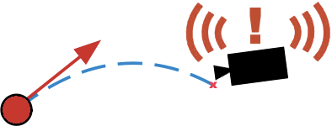
Description
Goal: Detect a ball moving towards the camera, and predict if the ball will hit the camera.
References:
FastTrack by Lior Chen. Tracking an orange ball. lirtex.com 2010
OpenCV (Open Source Computer Vision). Opencv.org
Physics of Baseball & Softball, Ch. 3 Ball Trajectories by Rod Cross. Springer 2011
Small Unmanned Aircraft – Theory and Practice. Randal W. Beard, Princeton 2012
Topological Structural Analysis of Digitized Binary Images by Border Following. Satoshi Suzuki 1985
Improved Adaptive Gaussian Mixture Model for Background Subtraction. Zoran Zivkovic 2004

Slide 3
What We Did
Started with Lior Chen’s FastTrack project. Re-wrote it as C++ application in Visual Studio 2010
Pause playback, step through frames (camera, video, images)
Parameter sliders and logging
Very accurate tracking with filtering and contour detection
Distance estimation function and camera calibration
Dynamic model and prediction in MATLAB
Implemented dynamic model and prediction in C++.

Slide 4
Algorithm
Implemented in OpenCV 3.0.0-beta, C++
Runs in real-time
Tuned for each scenario
Read Frame
Video file
Image
Filter
Color threshold
Background model
Detect Ball
Predict Impact
Time To Contact
Run Dynamic Model
Detect contours
Equations of motion
Largest Object
Impact Decision
Euler Integration
Camera
Noise reduction

Slide 5
Filter Algorithm
Background
Subtraction *
Frame In
Gaussian Filter *
HSV
Threshold
Frame Out
Morphological
Filter
Optional (can be turned on and off during run-time).
Notes:
Background subtractor and HSV output are ANDed together.
Order of topology is mostly fixed (Gaussian can move, but it’s best to blur the thresholded image in our experience)
Gaussian and morph filter both help to “repair” ball shape lost in HSV filter

Slide 6

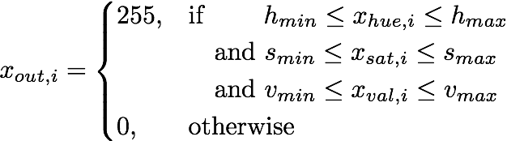
Background Subtraction
Convert image to grayscale
Creates model of background
Learning disabled: scene is static
Subtract model, threshold with GMM to generate mask
HSV Threshold
Convert image to HSV
Generate a binary image by thresholding
Notes:
V_min is most sensitive parameter in HSV Threshold
HSV threshold values must be tuned for every new lighting condtion or object
If background subtract is enabled we AND the result with the HSV filter

Slide 7



Gaussian Filter
Convolve grayscale image with Gaussian kernel to blur
Removes noise, recovers shape
Morphological Filter
Brightness of each pixel from comparison with neighbors
Elliptic structuring element sensitive to shapes (ball)
Erode: Removes pixels from boundaries
Dilate: Adds pixels to boundaries (preserve radius)
Notes:
Guassian blur of mask removes high frequency noise and smoothes edges of ball (caused by HSV)
Morph filter lets us filter out non-ball shapes
Expand/contract edges of ball to repair what filter accidently took out.

Slide 8
Detection Algorithm
Yes
Hough Circle Transform
Frame In
Hough ?
Find Largest
Contour Detection
Ball Info
Notes:
We use either Hough transform or contour detection. Not both.

Slide 9
Hough Circle Transform
Uses Canny edge detector
Generalized Hough transform on gradient for circle eq.
Robust, but slow, and detected radius is noisy.
Contour Detection
Detect border pixels by looking at neighbors
Finds rasterized contours and hierarcy from scan
Compute moment (Green’s theorem) for centroid & radius
Find Largest
Find circle/contour with largest radius where:
Notes:
Hough transform works, and is somewhat robust, but not for radius measurements. Only good for centroid detection
Contour Detection uses line by lines TV raster scan of each pixel, and build hierarchy of borders

Slide 10
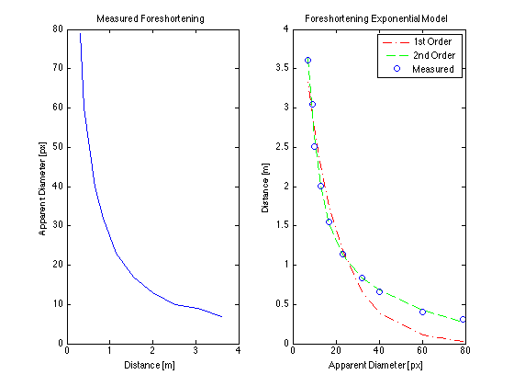

Distance Estimation
Fit exponential model to measured foreshortening
f(r) = a*exp(b*r) + c*exp(d*r)
Coefficients (with 95% confidence bounds):
a = 7.479 (5.066, 9.892)
b = -0.1759 (-0.245, -0.1069)
c = 1.7 (0.8402, 2.559)
d = -0.0231 (-0.03496, -0.01123)
Estimate distance each frame ball is detected:

Slide 11
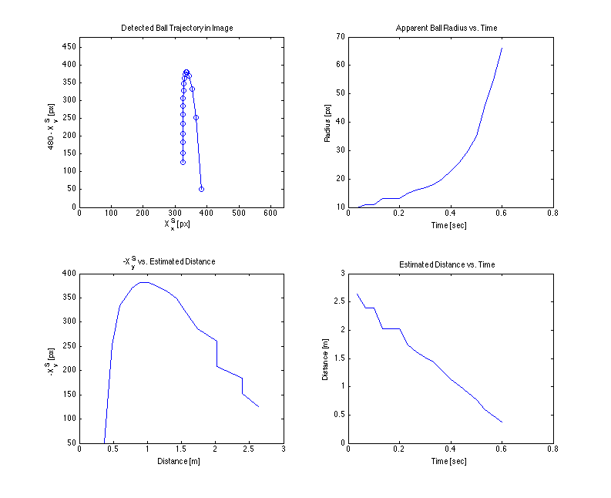

Slide 12






Distance Estimation continued…
Use distance estimation to find position of ball,
We also know from:
So we can solve for to find :
Update dynamic model each frame, since:

Slide 13
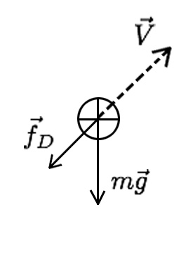

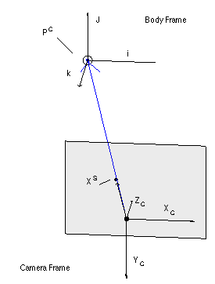

Dynamic Model
Free Body Diagram:
Assuming no rotation, ignore lift force. Use Newton’s second law:
From our FBD, we see that:
For state space, let
Notes:
Assuming no rotation since velocity is low. From data we saw that lift force

Slide 14

Dynamic Model continued…
Thus we end up with
Where is air density, is cross-sectional area of the ball, and is the drag coefficient. Gravity vector is positive in the camera frame.

Slide 15
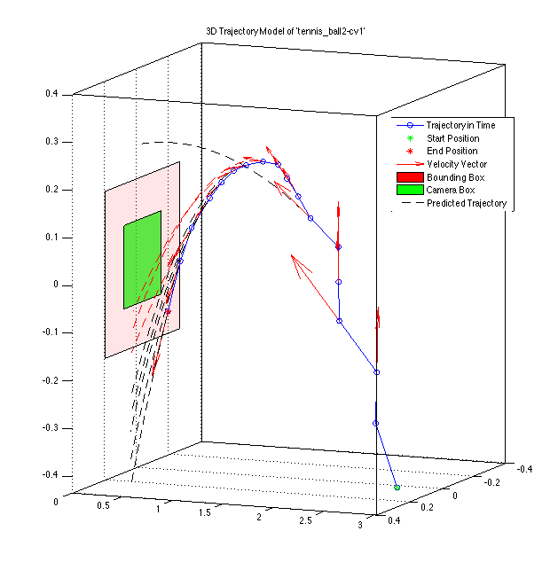


Trajectory Prediction
Find ball velocity using previous
update (camera frame):
Use forward Euler method to
predict velocity in seconds:
Finally, predicted position is:
Since
Notes:
Used \delta t_s = 1/500 [sec].
Run this for n iteration, or until we hit the focal plane.

Slide 16
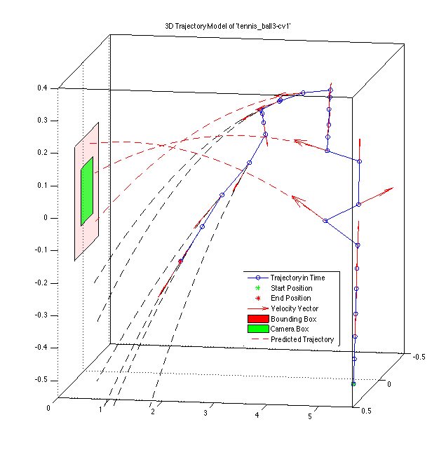
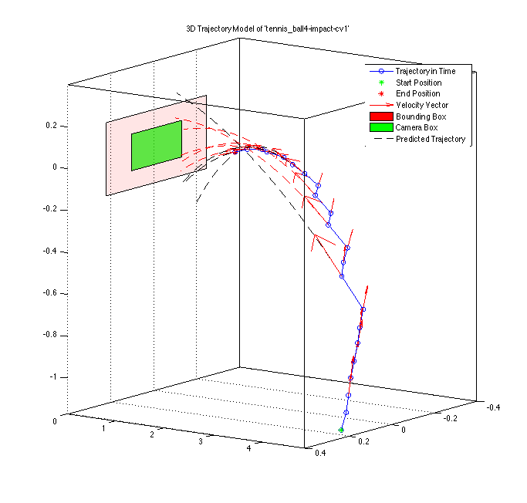

Slide 17

Impact Predictor
Run trajectory prediction max N steps, or until
Declare impact if:
Works, but distance estimates are noisy. Need to weight predictions based on time.
Where min and max x and y values define bounding box around focal plane.

Slide 18
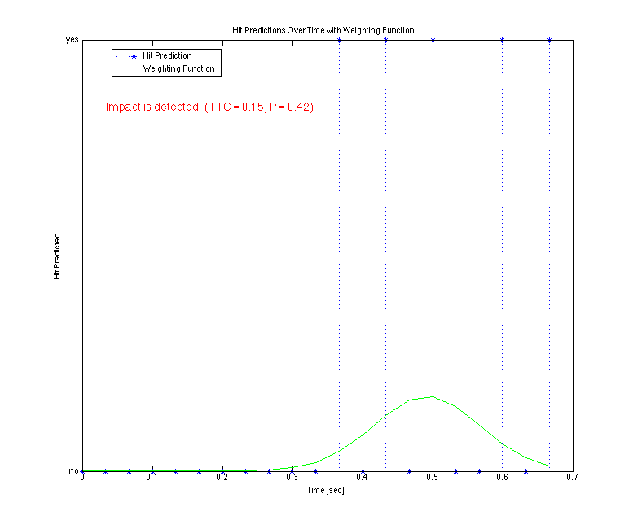

Slide 19
Future Work
Use machine learning to train hit predictor.
Implement Kalman filter for noisy measurements.
Automate filter tuning/calibration process.
Solve inverse problem (static scene, moving camera).

Slide 20
Dynamic Model
.
Init
Initial Speed
Initial Height
Set Coordinates Frame
Altitude above Track
Down Range
Integration
Loop
Stop Condition
Update
Drag Force & Gravity
Position
Velocities

